Slide 1


Postgraduate clinical training opportunities at the University of Sheffield
Ian Douglas
Director of the Sheffield Doctoral Academy
Head of Graduate School,
Faculty of Medicine, Dentistry & Health

Slide 2
Content
Where Sheffield is located
The University and its Faculties
The Faculty of Medicine, Dentistry & Health
Postgraduate clinical training opportunities

Slide 3
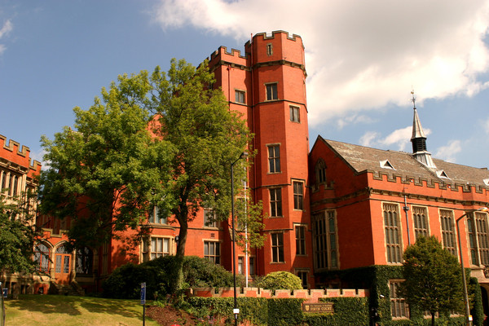
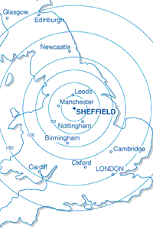
Where is Sheffield?
At the heart of the UK
  The greenest city
  One of the safest cities
2 hours from London
1 hour from Manchester International airport

Slide 4
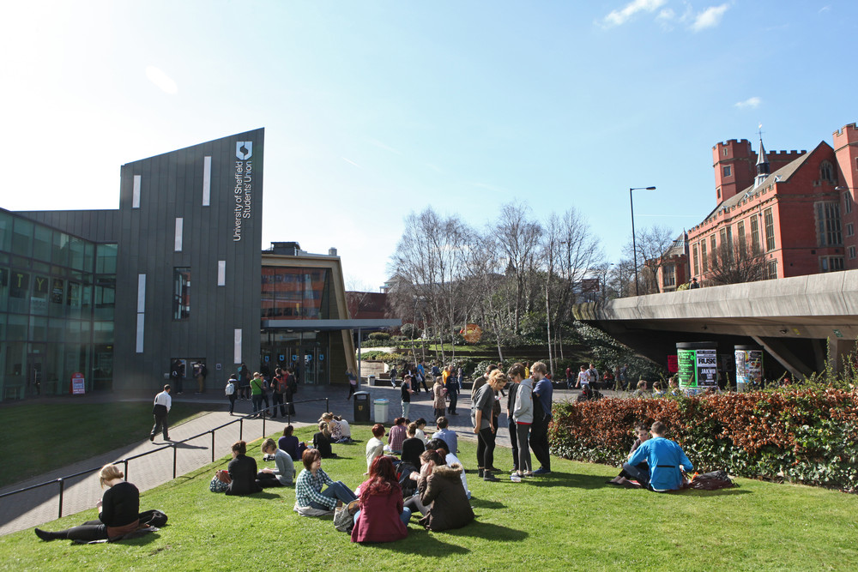
The University of Sheffield
  - One of the top 1% of universities in the world
  Top for student experience
  Top Students’ Union
  - 26,000 students from 125 countries
Notes:
A new world class facility for students, staff and the community at the heart of the campus, as well as being integrated with the University’s award-winning Students' Union in one single building.
The newly refurbished and redesigned building will provide state of the art facilities for student services, an amphitheatre styled space for special events will be created within the new Octagon Plaza, as well as more social and study spaces open for longer hours.
The new facility will be designed to complement the £5 million revamp which was carried out on the award-winning Students’ Union in 2010 and will help create a strong sense of community and belonging at the heart of the campus.
The new, integrated building will meet the needs of everyone on campus, with the whole complex being renamed the Students' Union Building.
Refurbishment work started in July 2012 and finishes in September 2013.

Slide 5
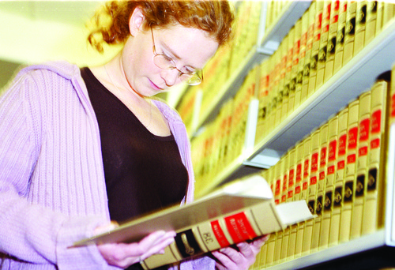
Study at Sheffield
  Range of study possibilities:
    Full-time and part time on campus
    Distance learning
    Joint location – research conducted in two or more locations with local supervision
    Remote location – research conducted off campus, with regular visits by supervisor/student

Slide 6
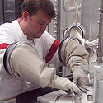

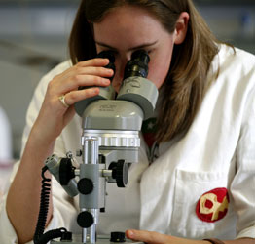
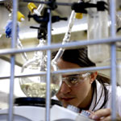


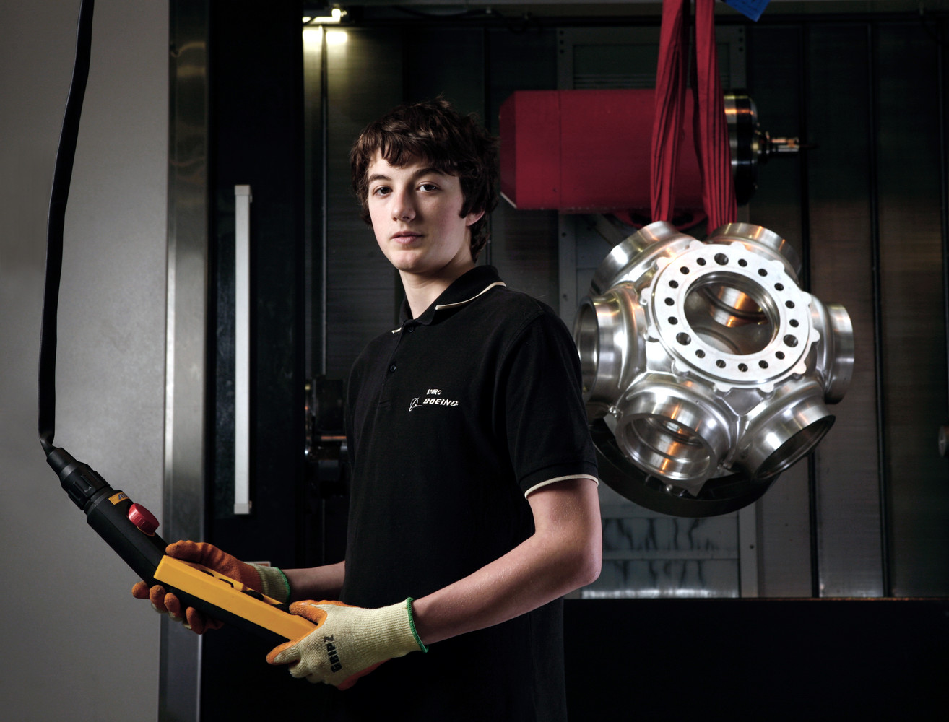


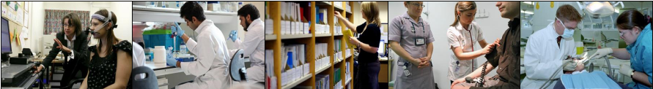
Faculty
Of
Science
Academic studies are divided into 5 Faculties
Faculty
Of
Social Sciences
Faculty
Of
Social Sciences
Faculty
Of Engineering
Faculty of Arts & Humanities
Faculty Of Medicine
Dentistry &
Health

Slide 7
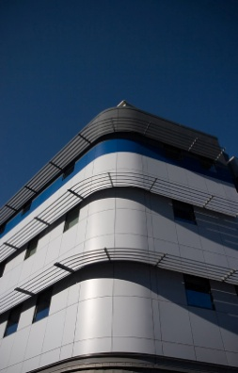
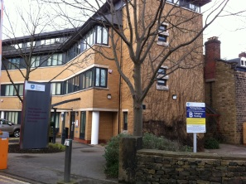

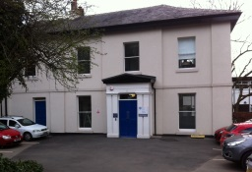

Faculty Academic Departments
Clinical Dentistry
Human Communication Sciences
Health and Related Research
Nursing & Midwifery
Medicine
  Cardiovascular Science
  Oncology
  Human Metabolism
  Neuroscience
  Infection & Immunity
Providing 40 Postgraduate taught programmes

Slide 8

Clinical training in the UK
Universities
  Provide academic training
    including research
  Basic clinical training up to first degree level
    includes supervised patient treatment
  Postgraduate clinical qualifications
    only a few examples
National Health Service
  Provides clinical care
  Clinical training
    for qualified staff
    guided experience on the clinic

Slide 9
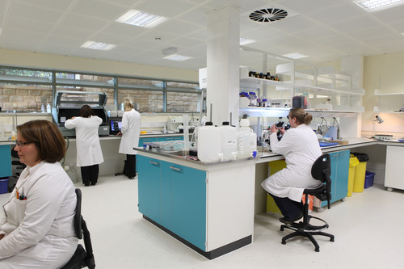
MSc in Clinical Neurology
1 year full time - Two routes of study
  Science route and Clinical route
  Both study core taught modules
Science route students
  choose a clinically oriented research project
Clinical route students
  placed with a clinical team to gain extended knowledge in their chosen specialist field.
Clinical route students need a medical degree and must be eligible for GMC registration
  Students do not need to have registered with the GMC before starting the course
English language requirements - overall IELTS 7.0

Slide 10
MSc in Clinical Neurology cntd.
Core modules are:-
  Cerebrovascular Disease and Disorders of Consciousness
  Neuroinflammation (CNS) and diseases of the PNS
  Applied Neuro-anatomy & Clinical Neuroscience
  Neurodegeneration
Mode of learning –
  Lectures, Seminars, Integrated Learning Tutorials, Clinical experience, Practical demonstrations, Student-led group work

Slide 11
Other Clinical Training Opportunities
Master of Medicl Science in Clinical Communication Studies
Doctorate of Clinical Dentistry
Developing a new model:
a doctorate in specialist clinical training

Slide 12

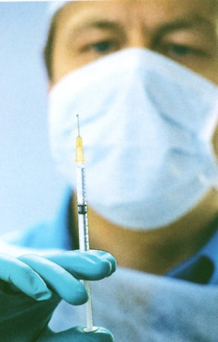
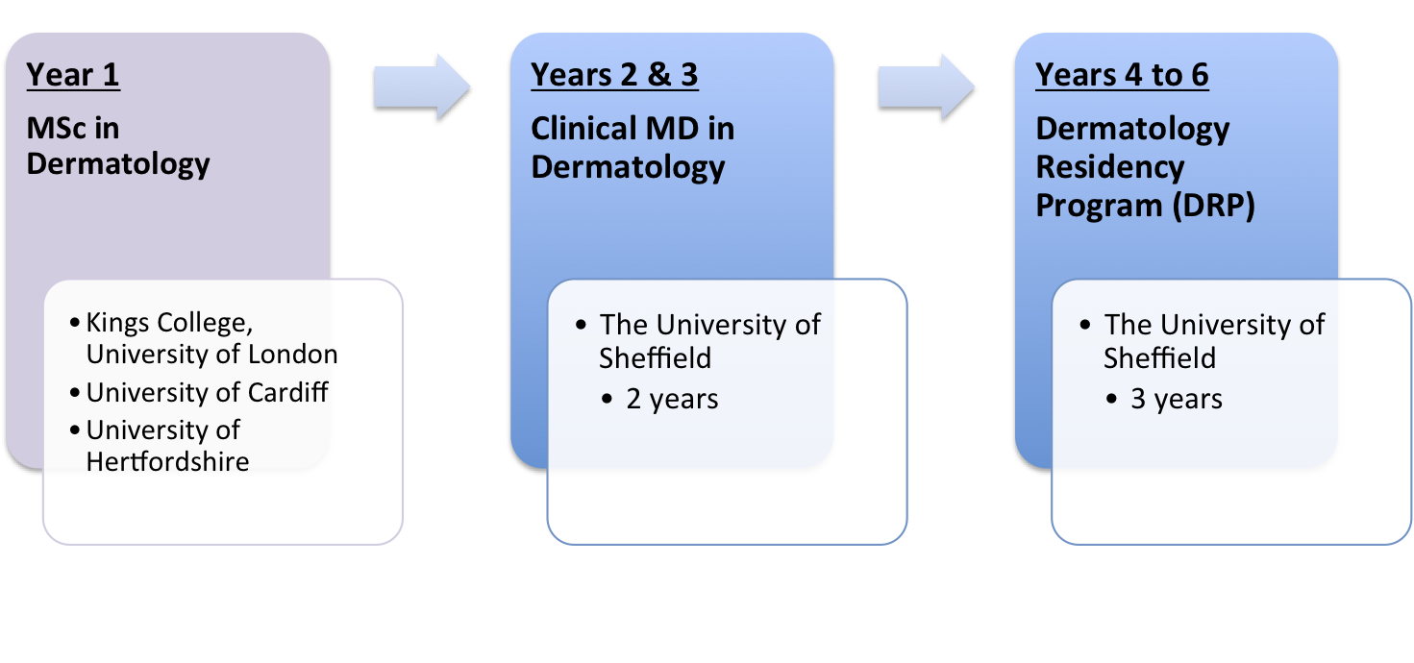
Doctorate in Specialist Dermatology
MD + Dermatology Residency Program
Two-year Clinical MD in Dermatology
  3 days per week training in clinical dermatology research
  2 days per week clerking and examining patients, treatment planning and attending on-call

Slide 13
Dermatology Residency Programme
To allow overseas medical graduates to receive additional specialty training in dermatology
Evaluation of residents will be via clinical case assessments
At the end of the programme, the resident will sit the “Specialty Certificate Examination in Dermatology”

Slide 14
Outline of Clinical Experience
Residents will:-
  Be allocated clinics at the Sheffield Teaching Hospitals, Sheffield Children’s Hospital and other affiliated hospitals.
  Examine and treat patients under direct supervision
    benefit from a one-on-one teaching experience,
    participate in weekly ward rounds, inpatient management, assessment and treatment of emergency admissions

Slide 15
Example rotations
Rotation | Duration
General Dermatology | 12 months
Paediatric Dermatology | 6 months
Dermatological Surgery | 3 months
Laser Surgery | 3 months
Dermatopathology | 3 months
Photobiology | 3 months
Hair diseases | 3 months
The final year will consist of the residents’ preferred subspecialty.

Slide 16
Entry to the Residency Programme
Entry requirements
  Medical graduate from a recognized international medical school
  A MSc in Clinical Dermatology from a recognized UK University
  A clinical MD from The University of Sheffield
    provides equivalence to specialist senior registrars eligible for nomination for GMC registration.
    possession of an MD in Clinical Dermatology does not guarantee a place on the DRP
  Need to be registered with the GMC

Slide 17
Future
There is interest in developing similar programmes in
  Respiratory diseases
  Plastic surgery
  Orthopaedics

Slide 18
To
Discover and
Understand
Thank you

